Slide 1
CPRG 307
Module 10
Software Testing

Slide 2
Objectives
Look at application testing:
Why we test
Test levels
Types of tests
What should be tested
Test Documentation
How testing will be incorporated into this course

Slide 3
Why We Test Applications

Slide 4
Why do we test?
How do you know your program works?
No, the answer is not “it compiles”
Compiling simply means there are no syntax errors
Compiling is absolutely necessary, but this is not what we mean by application testing
Testing refers to the idea that your program works as intended
The final result (output) is what is expected given specific input
We have no logical errors

Slide 5
Common Definitions…
There are variations in definitions when it comes to testing terminology
To ensure we are consistent in our conversations (using a common language) we will define our terms in this module

Slide 6
Test Levels

Slide 7
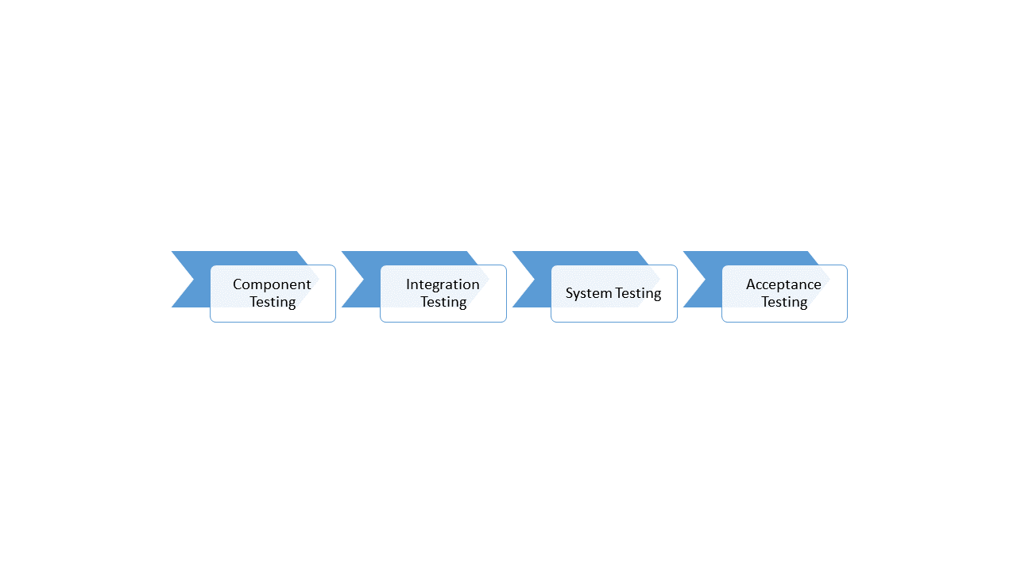
Test Levels Overview

Slide 8
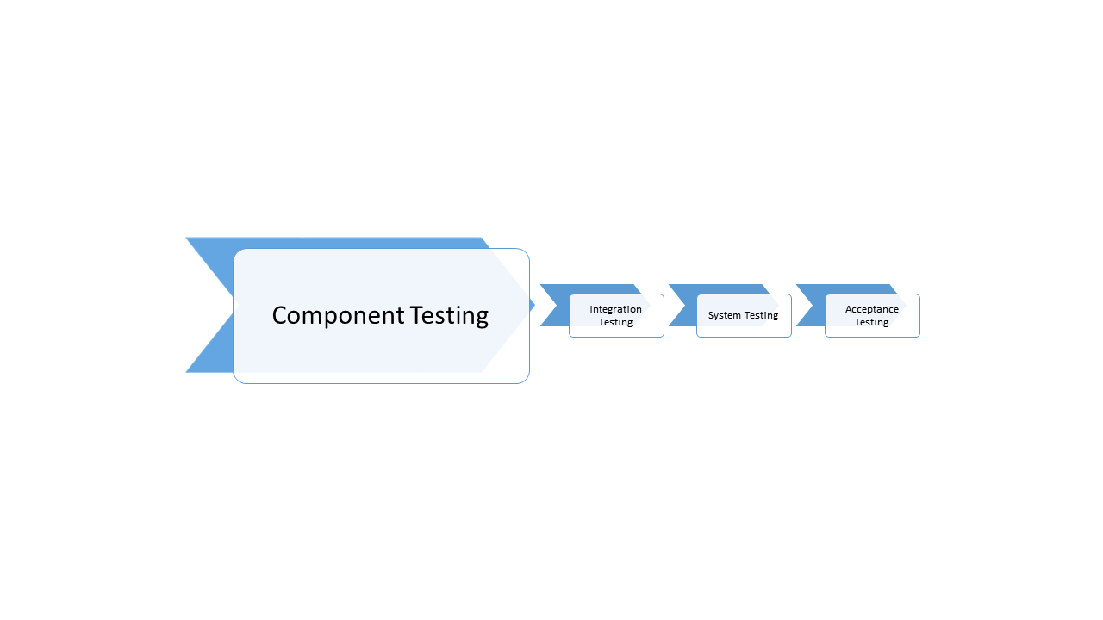
Test Levels – Component Testing

Slide 9
Test Levels – Component Testing
We will focus much of our testing time in this class on component testing
Also called Unit Testing
Sometimes Unit Testing and Component Testing are considered different levels of tests. For this course, we will consider them to be the same
Tests the smaller pieces (components of code)
Each stored program (procedure, function, trigger) is tested as a single unit rather than part of the bigger application
These would correlate to a method in Java
If outside of a stored program (anonymous block) we consider each structured block to be a component (each IF, each Loop, etc.)
As we add each structured block we test
This means we “test as we go” not wait to the end to test

Slide 10
Test as you go!!
Why do we test as we go?
Why not just create all of our code and then test it?
Why do we need to test the small pieces?
It takes so much time stopping to test when I could just continue to write the code

Slide 11
Test as you go!!
Because it actually saves time in the end
If I have five pages of code (a small program), and I have done no testing until the end, what part of the code is causing a problem with my expected output?
Is it the first, second, fifth IF statement?
Is it the INSERT or the UPDATE?
You now have to spend what could be hours (if lucky) trying to isolate WHERE the problem is. This takes a lot of time
If you test as you go, you do not have to worry about the WHERE – you know the exact location so you can just focus on the correction

Slide 12
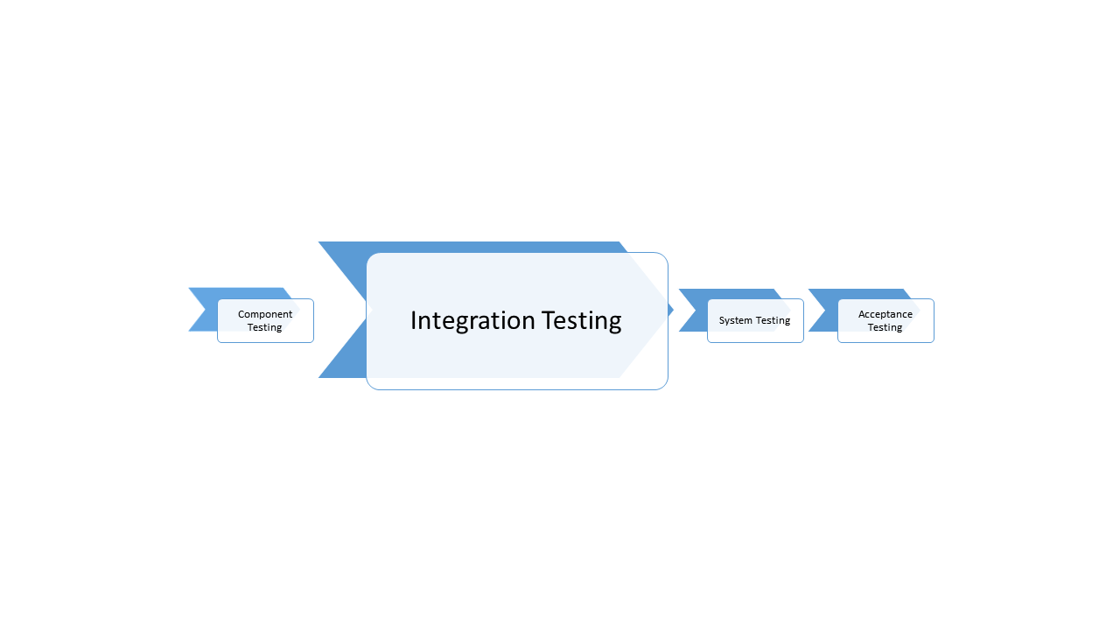
Test Levels – Integration Testing

Slide 13
Test Levels – Integration Testing
We will focus much of our testing time in this class on integration testing
You have tested all of the small pieces, now you need to put the pieces together
Integration testing is testing that ensures those pieces are working together as expected
You know your loop works correctly, you know your IF works correctly, but do you know when you put them together they will still perform as expected?

Slide 14
Test Levels – Integration Testing
This testing is important when working on all code yourself, but it becomes vital when part of a team and components are written by different team members
Everyone codes different so this can sometimes lead to problems when two pieces have two (or more) different authors
Do not get complacent and think “we have a standard on our team so everything will work perfectly together – we’ll test later”
This is a panicked disaster waiting to happen

Slide 15
Test Levels – Integration Testing
What has been described previously is what we call component integration (which will be our focus in this class)
There is also system integration
An entire system is not necessary just one large piece of code, one language, one machine, one operating system, one device
System integration testing looks at all of these pieces and tests how they work together

Slide 16
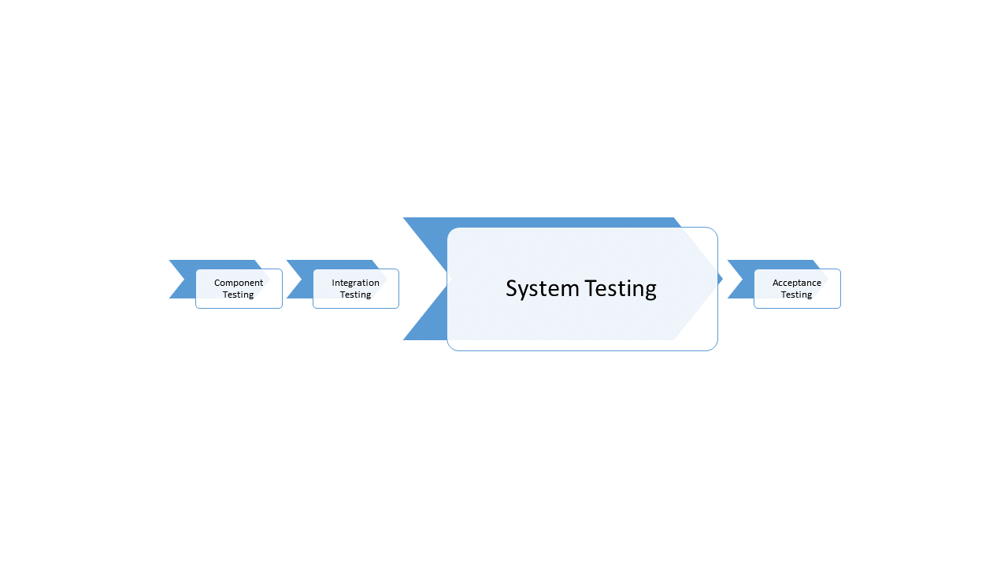
Test Levels – System Testing

Slide 17
Test Levels – System Testing
Tests the entire application as one single piece to ensure it meets the requirements as set out in the system design
It tests the functional requirements of the application (e.g. A student is registered in the database correctly, the report is automatically generated)
It tests the non-functional requirements of the application (e.g. the usability of the application, the web application works on both Firefox and Chrome)
We will not be performing any system testing in this course, but this will be a testing level that is vital to your capstone project

Slide 18
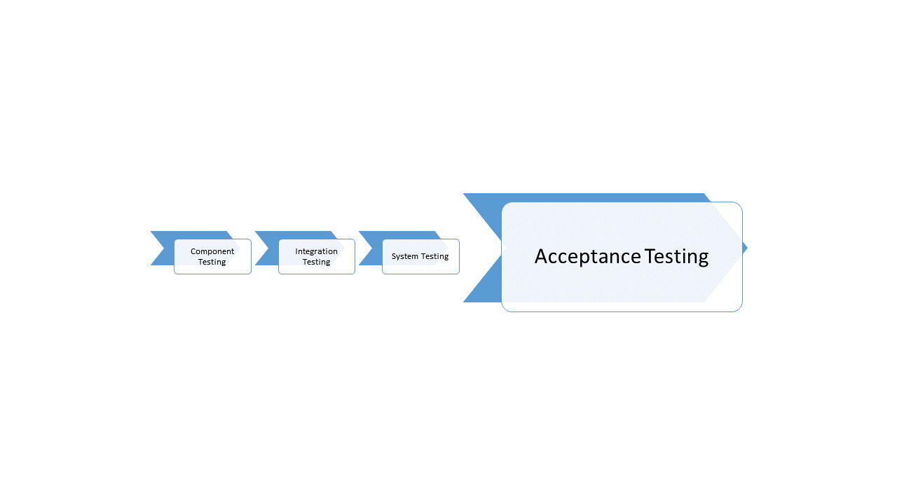
Test Levels – Acceptance Testing

Slide 19
Test Levels – Acceptance Testing
Also called User Acceptance Testing
This level of testing is when we get users or customers involved
Customers can go into the system and perform activities that they have requested and provide feedback on their experience
This is the last level of testing
We start with customers when we design applications and we end with customers as they hopefully accept the product that has been developed
As with system testing, we will not be focusing on acceptance testing in this course, but this will be a component of your capstone project

Slide 20
Types of Tests

Slide 21
Test Types…
There are many different types of tests available to us. In this class we are going to keep it small and simple.
Our focus is on functional testing (testing what the program does)
The following types of tests can be used for either component or integration testing

Slide 22
Test Types…
Dynamic Testing
Code is executed
Static Testing
The code is not actually executed

Slide 23
Test Types…
White-box Tests
We can look at the code and how the application is performing its job
Black-box Tests
We do not look at the code
Based on the specifications, we are seeing what we get as output based on specific input

Slide 24
Test Types…
Static White-box Testing
We combine our two definitions:
We do not execute the code
We can view the code
Think of this as a code review
We are looking at code to identify flaws or defects
Are coding standards being followed

Slide 25
Static White-box Focus…
The main task we will be focused on is:
Reviewing our code:
Are standards maintained
No literal values are used that can be retrieved from the database
Any literal values are in the DECLARE section
Naming standards adhered to (especially on a team or when defined in an organization)
Are restrictions / limitations identified in the specification followed
Quality
Does the code follow good programming standards
Is the code readable
Inline documentation included
Is the code maintainable

Slide 26
Test Types…
Dynamic Black-box Testing
We combine out two definitions:
We execute the code
We cannot / do not look at the code (we focus on the what)
In this course, when we are testing functionality, we will be using this type of testing
We will test our code for successful processing
Processing where no run-time errors occur
Processing where no handled exceptions occur
We will be testing our code for unsuccessful processing

Slide 27
Dynamic Black-box Focus…
The main functionality we will be focused on is:
We will test our code for successfully processing (this will be our definition of test-to-pass)
Processing where no run-time errors occur
Everything, including anticipated errors, is handled cleanly
The program does not crash in the beginning, middle, or end
The program ends in a controlled manner
Processing where no exceptions occur
Clean data is processed – no exceptions are anticipated

Slide 28
Dynamic Black-box Focus…
The main functionality we will be focused on is:
We will be testing our code for unsuccessful processing (this will be our definition of test-to-fail)
Unanticipated actions / errors
These types of problems cause run-time errors which we must eliminate
Our programs must be able to handle the unexpected
Processing data that will throw exceptions
When we are processing data (whether directly from user input or a batch load) the data is not always perfect. We need to anticipate what some of the erroneous data will be, process the erroneous data, and give clear, specific feedback to users on how to correct the data
We need to test exception handlers that we have created

Slide 29
What should be tested

Slide 30
What data should be used in testing?
This greatly depends on what we are testing, but here are some general guidelines (not an absolute list):
NULLs
NULL values are one of two headaches for programmers (the second one is coming up next)
Always assume data input could potentially be NULL unless it is being retrieved from a database column that has a NOT NULL constraint
Even if NULL is not considered a valid value, test to see what your code will do if a NULL is erroneously used as input

Slide 31
What data should be used in testing?
Dates
Dates are the second headache for programmers
Never assume a default format for your dates when retrieving them from the database (this can vary from database to database)
Your code should always use an appropriate conversion function for dates if having to convert them to a string
In Oracle, this would be a TO_CHAR function
If a date is a string value coming in as input, you will need to know the format of this string, so test to see if the input is in the correct format
In Oracle, to convert a string to a date would be a TO_DATE function
Check comparison points when comparing a date data type to a string data type – was a conversion function used? If not, you should be using one.

Slide 32
What data should be used in testing?
Boundaries
If input coming into a component or application can have a range of values, it is usually not worth the time and effort testing every potential input
For example, an application can have a valid input number between 2 and 2,000,000 (do you really want to run almost two million tests?)
Test a few valid inputs in the range, but make sure to test the boundaries as this is where applications tend to have issues
2
2,000,000
1
2,000,001
Remember that you are testing both clean data (test-to-pass) and erroneous data (test-to-fail)

Slide 33
Test Documentation

Slide 34
Test Documentation…
There are many formal ways of documenting tests, we are going to stay on a more informal side
We document tests so we can determine what tests we should perform and the results of those tests
Test plans should be roughed in before coding begins
Test to the specifications not to your code
Your code may miss something so the test plan is another checklist if it has been guided by the specification

Slide 35
Test Plan Example…

Slide 36
How We Will Test…

Slide 37
How will we test in this course?
Testing will be integrated into everything we do – labs, assignments, quizzes, exams
Sometimes assessments will specifically tell you to show your tests or ask what tests should be performed
Sometimes assessments will expect you to test but will not ask for testing information
Testing should be second nature to a software developer. You cannot be a successful software developer without expecting to thoroughly test all software components

Slide 38
Food for Thought
Always code as if the guy who ends up maintaining your code will be a violent psychopath who knows where you live.
- Martin Golding
Photo: Colourbox.com

